Slide 1





PAYROLL(SALARAY) MANAGEMENT CHETHAN M PES2201800331
DATABASE MANAGEMENT PROJECT

Slide 2
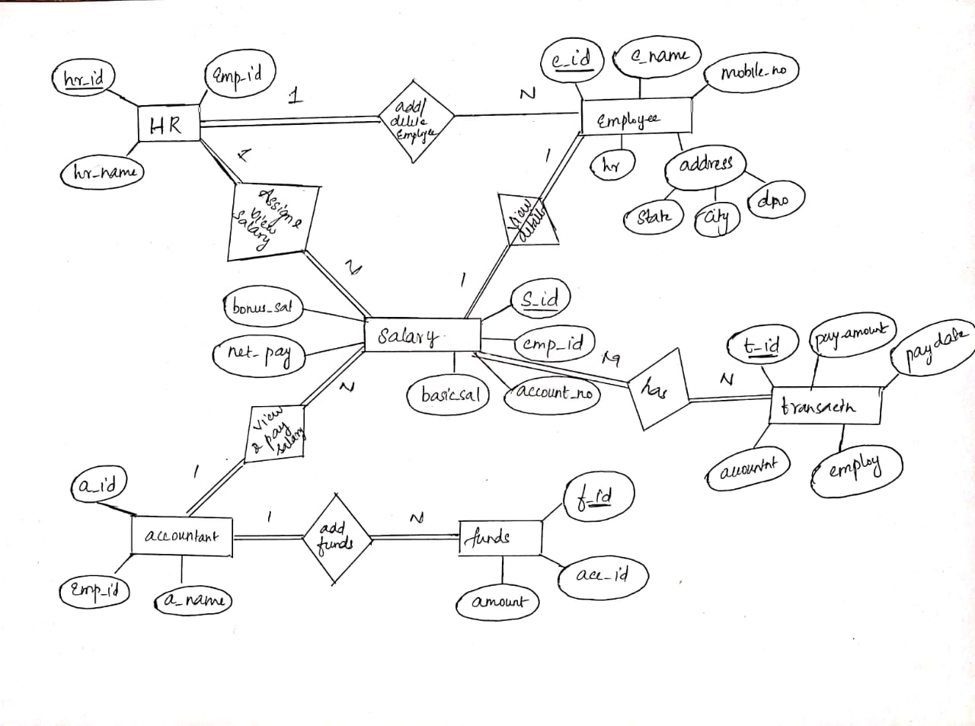
ER DIAGRAM

Slide 3
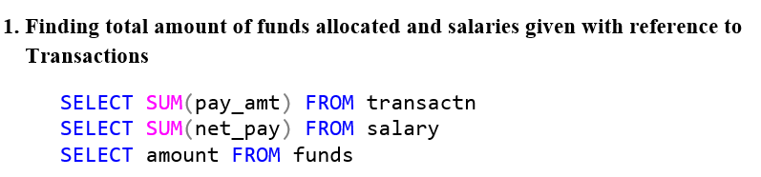
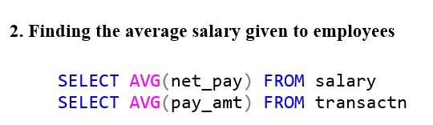
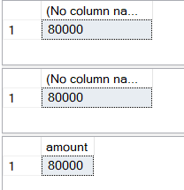
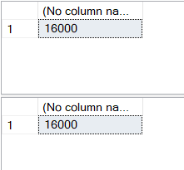
AGGREGATE QUERIES
Notes:
When conducting research, it is easy to go to one source: Wikipedia. However, you need to include a variety of sources in your research. Consider the following sources:
Who can I interview to get more information on the topic?
Is the topic current and will it be relevant to my audience?
What articles, blogs, and magazines may have something related to my topic?
Is there a YouTube video on the topic? If so, what is it about?
What images can I find related to the topic?

Slide 4
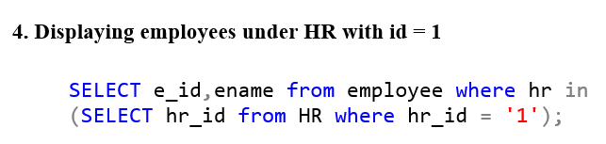
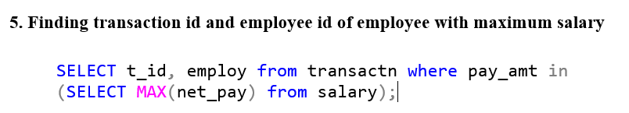
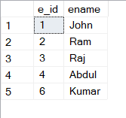
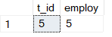
NESTED QUERIES
Notes:
When conducting research, it is easy to go to one source: Wikipedia. However, you need to include a variety of sources in your research. Consider the following sources:
Who can I interview to get more information on the topic?
Is the topic current and will it be relevant to my audience?
What articles, blogs, and magazines may have something related to my topic?
Is there a YouTube video on the topic? If so, what is it about?
What images can I find related to the topic?

Slide 5
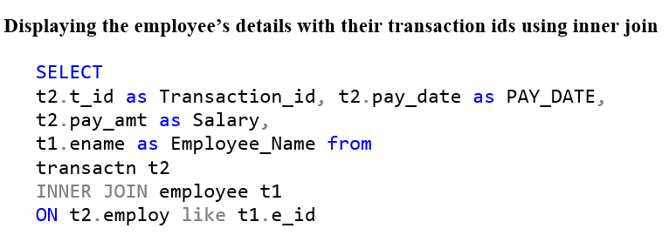
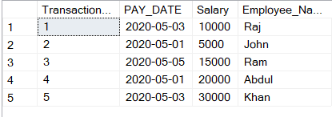
INNER JOIN QUERY
Notes:
When conducting research, it is easy to go to one source: Wikipedia. However, you need to include a variety of sources in your research. Consider the following sources:
Who can I interview to get more information on the topic?
Is the topic current and will it be relevant to my audience?
What articles, blogs, and magazines may have something related to my topic?
Is there a YouTube video on the topic? If so, what is it about?
What images can I find related to the topic?

Slide 6
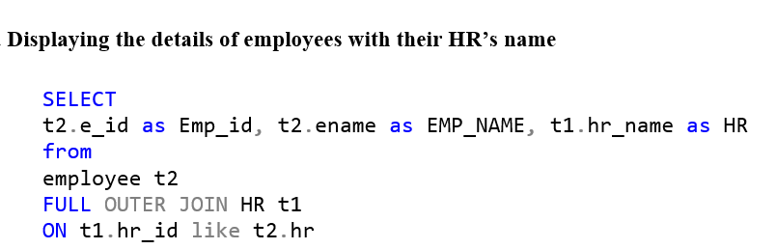
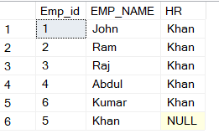
FULL OUTER JOIN QUERY
Notes:
When conducting research, it is easy to go to one source: Wikipedia. However, you need to include a variety of sources in your research. Consider the following sources:
Who can I interview to get more information on the topic?
Is the topic current and will it be relevant to my audience?
What articles, blogs, and magazines may have something related to my topic?
Is there a YouTube video on the topic? If so, what is it about?
What images can I find related to the topic?

Slide 7
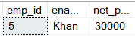
CORRELATED-NESTED QUERY
A correlated nested query (or correlated sub-query) is a sub-query that has a different result depending on values in the row of the outer query for which the sub-query executes.
Displaying the employee id, employee name and salary of the employee with highest salary
SELECT t1.emp_id, t2.ename, t1.net_pay
FROM employee as t2
INNER JOIN salary as t1
ON t1.emp_id = t2.e_id
WHERE t1.net_pay =
(SELECT max(net_pay) from salary)
FUNCTIONALITIES USED:
Correlated sub-query
Nested query
Inner join
Notes:
When conducting research, it is easy to go to one source: Wikipedia. However, you need to include a variety of sources in your research. Consider the following sources:
Who can I interview to get more information on the topic?
Is the topic current and will it be relevant to my audience?
What articles, blogs, and magazines may have something related to my topic?
Is there a YouTube video on the topic? If so, what is it about?
What images can I find related to the topic?

Slide 8
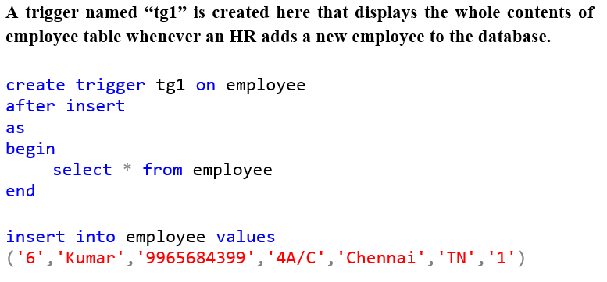
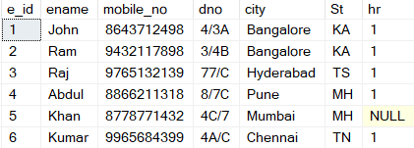
TRIGGER-1
The above table automatically gets displayed once the insert query is executed
An insert query is executed after creating the trigger tg1 to test its function.
Notes:
When conducting research, it is easy to go to one source: Wikipedia. However, you need to include a variety of sources in your research. Consider the following sources:
Who can I interview to get more information on the topic?
Is the topic current and will it be relevant to my audience?
What articles, blogs, and magazines may have something related to my topic?
Is there a YouTube video on the topic? If so, what is it about?
What images can I find related to the topic?

Slide 9
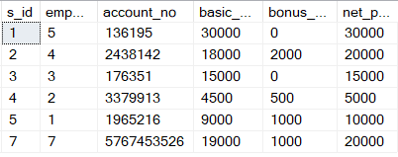
TRIGGER-2
create trigger
tg2 on employee
after insert
as
declare @log_action varchar(20); declare @e_id varchar(11);
declare @ename varchar(25); declare @mobile_no varchar(11);
declare @dno varchar(7); declare @city varchar(25);
declare @St varchar(25); declare @hr varchar(11);
select
@e_id = i.e_id, @ename=i.ename, @mobile_no=i.mobile_no,
@dno=i.dno, @city=i.city, @St=i.St, @hr=i.hr from inserted i;
set @log_action='inserted record';
insert into salary values('7',@e_id,'5767453526',19000,1000,20000);
insert into employee values('7','Michael','8778487775','7/3F','Bangalore','KA','1');
select * from salary
OUTPUT
Salary details of employee with employee id = 7 is automatically added to the salary relation.
Notes:
When conducting research, it is easy to go to one source: Wikipedia. However, you need to include a variety of sources in your research. Consider the following sources:
Who can I interview to get more information on the topic?
Is the topic current and will it be relevant to my audience?
What articles, blogs, and magazines may have something related to my topic?
Is there a YouTube video on the topic? If so, what is it about?
What images can I find related to the topic?

Slide 10
THANK YOU
Notes:
You can use this slide as your opening or closing slide. Should you choose to use it as a closing, make sure you review the main points of your presentation. One creative way to do that is by adding animations to the various graphics on a slide. This slide has 4 different graphics, and, when you view the slideshow, you will see that you can click to reveal the next graphic. Similarly, as you review the main topics in your presentation, you may want each point to show up when you are addressing that topic.
Add animation to images and graphics:
Select your image or graphic.
Click on the Animations tab.
Choose from the options. The animation for this slide is “Split”. The drop-down menu in the Animation section gives even more animations you can use.
If you have multiple graphics or images, you will see a number appear next to it that notes the order of the animations.
Note: You will want to choose the animations carefully. You do not want to make your audience dizzy from your presentation.

